Slide 1
IDS MINI-PROJECT
TEAM POKEMON
PES1201701532 : Zenkar S
PES1201700094 : Surya N
PES1201700930 : Abhimanyu

Slide 2
ABOUT DATASET —POKEMON:
Number of rows in the dataset: 800
Number of columns in the dataset: 13
Columns with Categorical data: 5
Columns with Numeric Data: 8
With missing values, incorrect nomencleture and blank type2 for pokemons of single type.

Slide 3
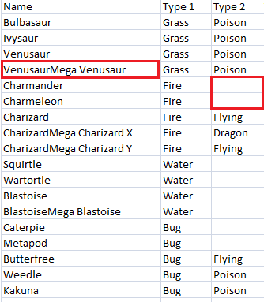
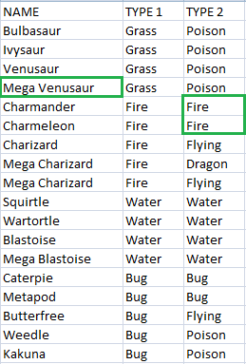
DATA CLEANING

Slide 4
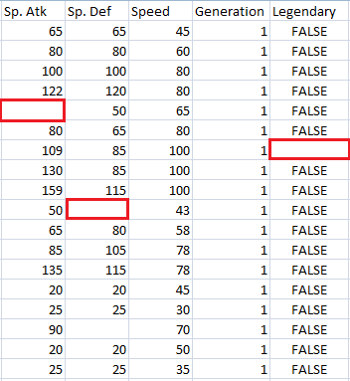
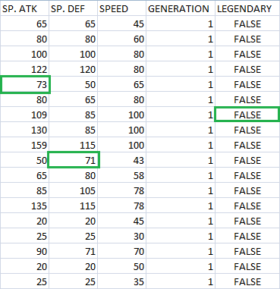

Slide 5
DATA VISUALIZATION

Slide 6
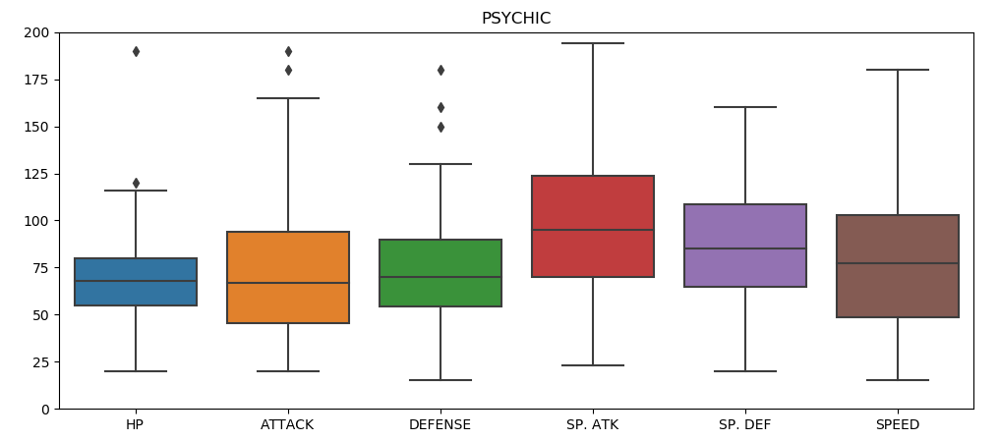
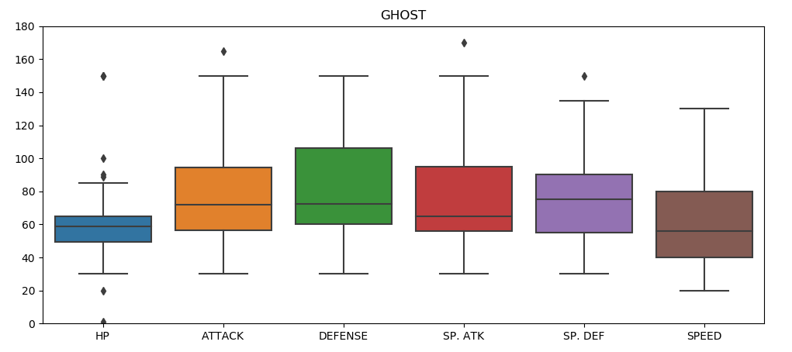
BOX-PLOT PSYCHIC v GHOST

Slide 7
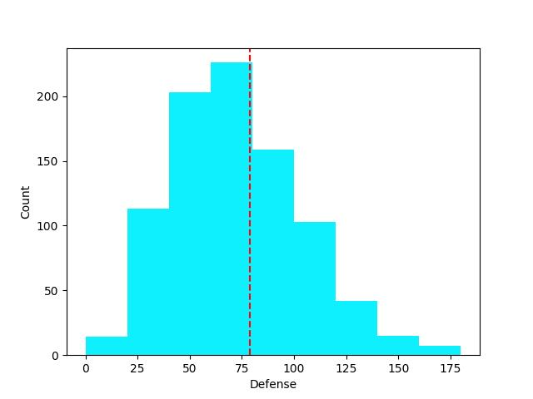
HISTOGRAM

Slide 8
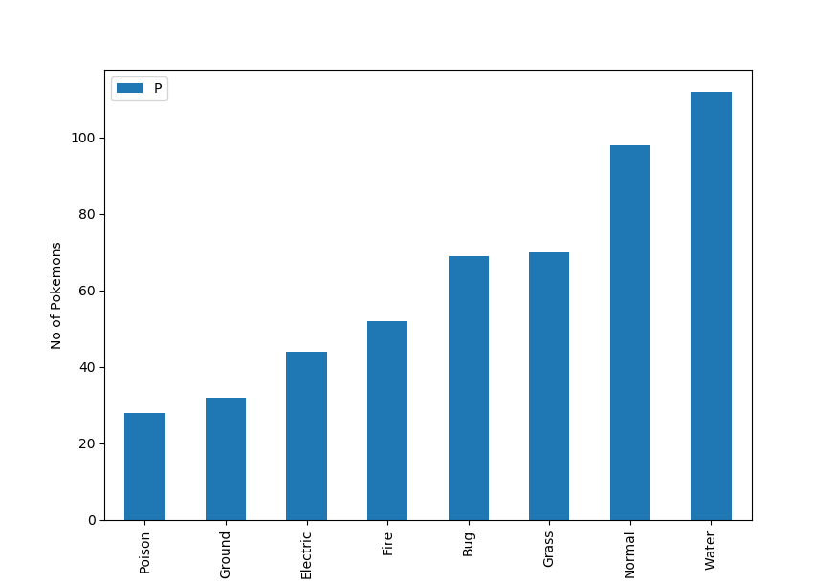
Bar Graph

Slide 9
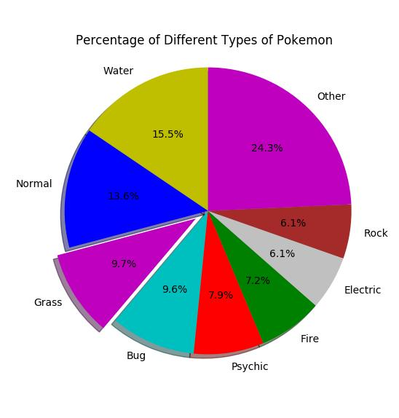
PIE CHART

Slide 10
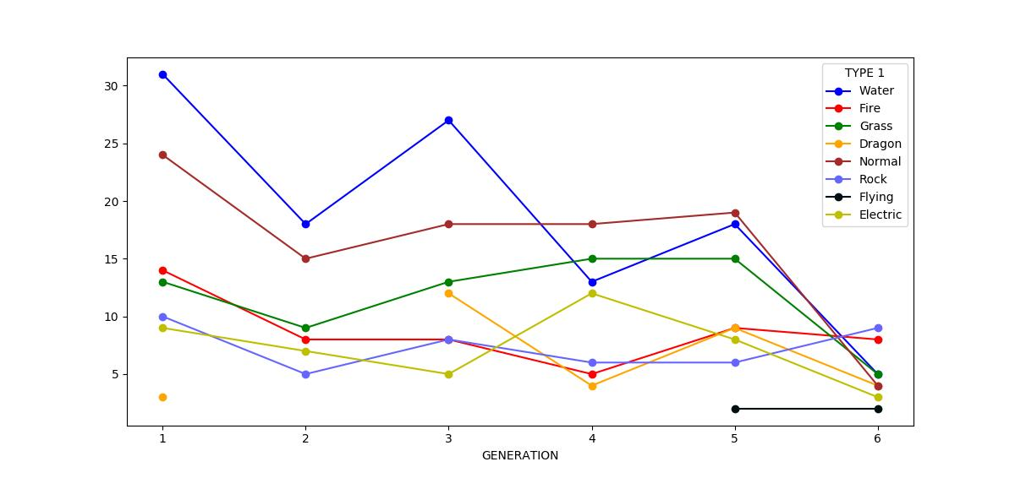
LINE GRAPH

Slide 11
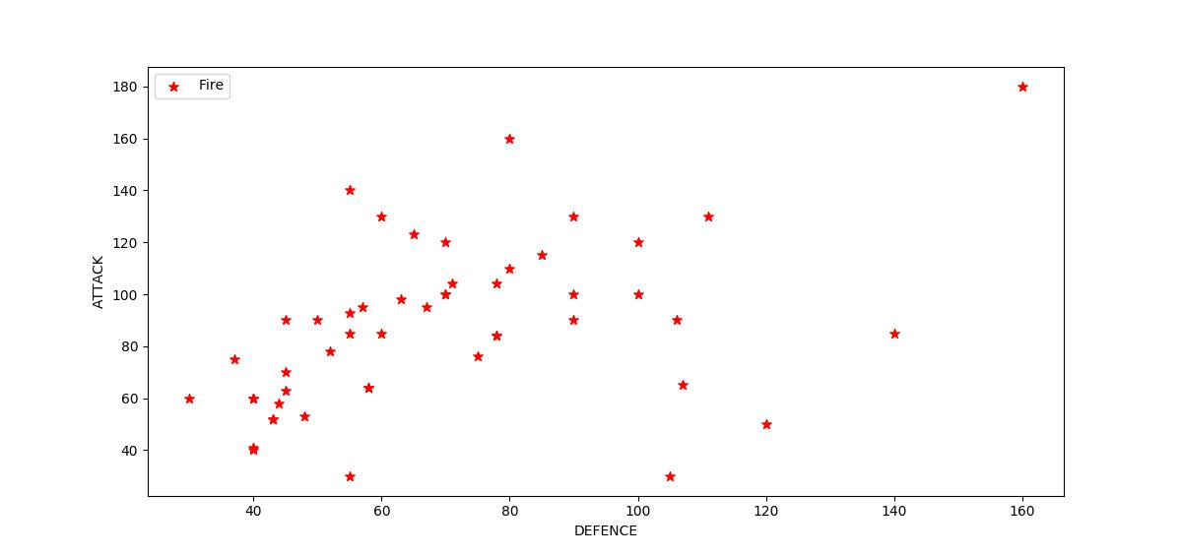
SCATTER-PLOT

Slide 12
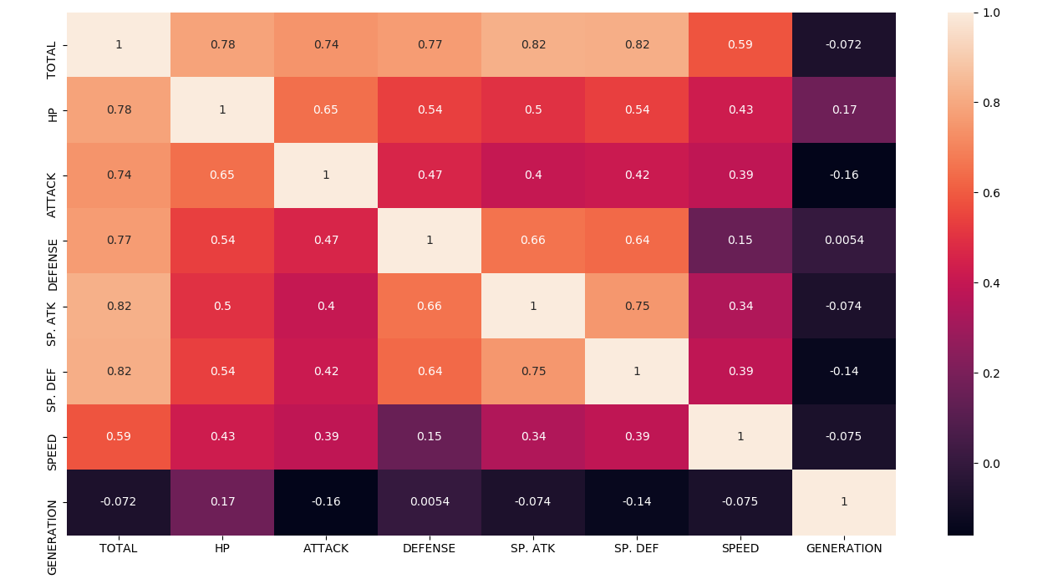
HEAT MAP FOR CORRELATION

Slide 13
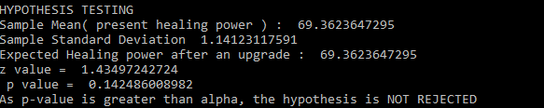
HYPOTHESIS TESTING
Null Hypothesis : Healing Power is less than or equal to 71
u <= 71
Alternative Hypothesis :
u> 71
No of Samples : 500
Size of each Sample : 100

Slide 14


